Slide 1
PYTHON BASICS AND DATA STRUCTURES
Notes:
SPM

Slide 2
Outline
Running Python and Output
Data Types
Control Flow
Dr Vijendra

Slide 3
Python is a general-purpose interpreted, interactive, object-oriented, and high-level programming language. It was created by Guido van Rossum during 1985- 1990
Dr Vijendra

Slide 4
Python is...
a scripting language (strong in text-processing)
interpreted, like Perl, but much more elegant
a very high-level language (closer to human)
  like Java, unlike C or Assembly
procedural
  like C, Pascal, Basic, and many more
but also object-oriented
  like C++ and Java
Dr Vijendra

Slide 5
Hello World
Open a terminal window and type “python”
If on Windows open a Python IDE like IDLE
At the prompt type ‘hello world!’
>>> 'hello world!'
'hello world!'
Dr Vijendra

Slide 6
Program Structure
C
#include <stdio.h>
int main(int argc, char ** argv)
{
printf(“Hello, World!\n”);
}
JAVA
public class Hello
{
public static void main(String argv[])
{
  System.out.println(“Hello, World!”);
  }
  }
Python
print “Hello, World!”
Dr Vijendra

Slide 7
Python Interpreter
Three ways to run a Python program
1. Interactive
  • like Java
2. (default) save to a file, say, test.py
  • in command-line: python test.py
3. add a special line pointing to the default interpreter
  • e.g. #! /usr/bin/python at the beginning of test.py
  • make test.py executable (chmod +x test.py)
  • in command-line: ./test.py
Dr Vijendra

Slide 8
The Python Interpreter
>>> 3 + 7
10
>>> 3 < 15
True
>>> 'print me'
'print me'
>>> print 'print me'
print me
>>>
Python is an interpreted language
The interpreter provides an interactive environment to play with the language
Results of expressions are printed on the screen
Dr Vijendra

Slide 9
The print Statement
Elements separated by commas print with a space between them
A comma at the end of the statement (print ‘hello’,) will not print a newline character
>>> print 'hello'
hello
>>> print 'hello', 'there'
hello there
Dr Vijendra

Slide 10
Documentation
The ‘#’ starts a line comment
>>> 'this will print'
'this will print'
>>> #'this will not'
>>>
Dr Vijendra

Slide 11
Variables
Are not declared, just assigned
The variable is created the first time you assign it a value
Are references to objects
Type information is with the object, not the reference
Everything in Python is an object
Dr Vijendra

Slide 12
Everything is an object
Everything means everything, including functions and classes (more on this later!)
Data type is a property of the object and not of the variable
>>> x = 7
>>> x
7
>>> x = 'hello'
>>> x
'hello'
>>>
Dr Vijendra

Slide 13
Numbers: Integers
Integer – the equivalent of a C long
Long Integer – an unbounded integer value.
>>> 132224
132224
>>> 132323 ** 2
17509376329L
>>>
Dr Vijendra

Slide 14
Numbers: Floating Point
int(x) converts x to an integer
float(x) converts x to a floating point
The interpreter shows
a lot of digits
>>> 1.23232
1.2323200000000001
>>> print 1.23232
1.23232
>>> 1.3E7
13000000.0
>>> int(2.0)
2
>>> float(2)
2.0
Dr Vijendra

Slide 15
Numbers: Complex
Built into Python
Same operations are supported as integer and float
>>> x = 3 + 2j
>>> y = -1j
>>> x + y
(3+1j)
>>> x * y
(2-3j)
Dr Vijendra

Slide 16
Numbers are immutable
x
4.5
>>> x = 4.5
>>> y = x
>>> y += 3
>>> x
4.5
>>> y
7.5
y
x
4.5
y
7.5
Dr Vijendra

Slide 17
Sequential Steps
x = 2
Program:
x = 2
print x
x = x + 2
print x
Output:
2
4
print x
x = x + 2
print x
When a program is running, it flows from one step to the next. As programmers, we set up “paths” for the program to follow.
Dr Vijendra

Slide 18
String Literals
Strings are immutable
There is no char type like in C++ or Java
+ is overloaded to do concatenation
>>> x = 'hello'
>>> x = x + ' there'
>>> x
'hello there'
Dr Vijendra

Slide 19
String Literals: Many Kinds
Can use single or double quotes, and three double quotes for a multi-line string
>>> 'I am a string'
'I am a string'
>>> "So am I!"
'So am I!'
>>> s = """And me too!
though I am much longer
than the others :)"""
'And me too!\nthough I am much longer\nthan the others :)‘
Dr Vijendra

Slide 20
Substrings and Methods
>>> s = '012345'
>>> s[3]
'3'
>>> s[1:4]
'123'
>>> s[2:]
'2345'
>>> s[:4]
'0123'
>>> s[-2]
'4'
len(String) – returns the number of characters in the String
str(Object) – returns a String representation of the Object
>>> len(x)
6
>>> str(10.3)
'10.3'
Dr Vijendra

Slide 21
String Formatting
Similar to C’s printf
<formatted string> % <elements to insert>
Can usually just use %s for everything, it will convert the object to its String representation.
>>> "One, %d, three" % 2
'One, 2, three'
>>> "%d, two, %s" % (1,3)
'1, two, 3'
>>> "%s two %s" % (1, 'three')
'1 two three'
>>>
Dr Vijendra

Slide 22
Lists
>>> x = [1,'hello', (3 + 2j)]
>>> x
[1, 'hello', (3+2j)]
>>> x[2]
(3+2j)
>>> x[0:2]
[1, 'hello']
Ordered collection of data
Data can be of different types
Lists are mutable
Issues with shared references and mutability
Same subset operations as Strings
Dr Vijendra

Slide 23
Lists: Modifying Content
x[i] = a reassigns the ith element to the value a
Since x and y point to the same list object, both are changed
The method append also modifies the list
>>> x = [1,2,3]
>>> y = x
>>> x[1] = 15
>>> x
[1, 15, 3]
>>> y
[1, 15, 3]
>>> x.append(12)
>>> y
[1, 15, 3, 12]
Dr Vijendra

Slide 24
Lists: Modifying Contents
>>> x = [1,2,3]
>>> y = x
>>> z = x.append(12)
>>> z == None
True
>>> y
[1, 2, 3, 12]
>>> x = x + [9,10]
>>> x
[1, 2, 3, 12, 9, 10]
>>> y
[1, 2, 3, 12]
>>>
The method append modifies the list and returns None
List addition (+) returns a new list
Dr Vijendra

Slide 25
Tuples
Tuples are immutable versions of lists
One strange point is the format to make a tuple with one element:
‘,’ is needed to differentiate from the mathematical expression (2)
>>> x = (1,2,3)
>>> x[1:]
(2, 3)
>>> y = (2,)
>>> y
(2,)
>>>
Dr Vijendra

Slide 26
Dictionaries
A set of key-value pairs
Dictionaries are mutable
>>> d = {1 : 'hello', 'two' : 42, 'blah' : [1,2,3]}
>>> d
{1: 'hello', 'two': 42, 'blah': [1, 2, 3]}
>>> d['blah']
[1, 2, 3]
Dr Vijendra

Slide 27
Dictionaries: Add/Modify
Entries can be changed by assigning to that entry
>>> d
{1: 'hello', 'two': 42, 'blah': [1, 2, 3]}
>>> d['two'] = 99
>>> d
{1: 'hello', 'two': 99, 'blah': [1, 2, 3]}
Assigning to a key that does not exist adds an entry
>>> d[7] = 'new entry'
>>> d
{1: 'hello', 7: 'new entry', 'two': 99, 'blah': [1, 2, 3]}
Dr Vijendra

Slide 28
Dictionaries: Deleting Elements
The del method deletes an element from a dictionary
>>> d
{1: 'hello', 2: 'there', 10: 'world'}
>>> del(d[2])
>>> d
{1: 'hello', 10: 'world'}
Dr Vijendra

Slide 29
Copying Dictionaries and Lists
>>> l1 = [1]
>>> l2 = list(l1)
>>> l1[0] = 22
>>> l1
[22]
>>> l2
[1]
>>> d = {1 : 10}
>>> d2 = d.copy()
>>> d[1] = 22
>>> d
{1: 22}
>>> d2
{1: 10}
The built-in list function will copy a list
The dictionary has a method called copy
Dr Vijendra

Slide 30
Input
The raw_input(string) method returns a line of user input as a string
The parameter is used as a prompt
The string can be converted by using the conversion methods int(string), float(string), etc.
Dr Vijendra

Slide 31
Input: Example
print "What's your name?"
name = raw_input("> ")
print "What year were you born?"
birthyear = int(raw_input("> "))
print "Hi %s! You are %d years old!" % (name, 2011 - birthyear)
~: python input.py
What's your name?
> Michael
What year were you born?
>1980
Hi Michael! You are 31 years old!
Dr Vijendra

Slide 32
Booleans
0 and None are false
Everything else is true
True and False are aliases for 1 and 0 respectively
Dr Vijendra

Slide 33
Boolean Expressions
>>> True and False
False
>>> False or True
True
>>> 7 and 14
14
>>> None and 2
>>> None or 2
2
Compound boolean expressions short circuit
and and or return one of the elements in the expression
Note that when None is returned the interpreter does not print anything
Dr Vijendra

Slide 34
No Braces
Python uses indentation instead of braces to determine the scope of expressions
All lines must be indented the same amount to be part of the scope (or indented more if part of an inner scope)
This forces the programmer to use proper indentation since the indenting is part of the program!
Dr Vijendra

Slide 35
Conditional Steps
x = 5
X < 10 ?
Yes
Program:
x = 5
if x < 10:
print 'Smaller’
if x > 20:
print 'Bigger'
print 'Finis'
No
print 'Smaller'
Output:
Smaller
Finis
X > 20 ?
Yes
No
print 'Bigger'
print 'Finis'
Dr Vijendra

Slide 36
Comparison Operators
Boolean expressions ask a question and produce a Yes or No result which we use to control program flow
Boolean expressions using comparison operators evaluate to - True / False - Yes / No
Comparison operators look at variables but do not change the variables
Python | Meaning
< | Less than
<= | Less than or Equal
== | Equal to
>= | Greater than or Equal
> | Greater than
!= | Not equal
Remember: “=” is used for assignment.
Dr Vijendra

Slide 37
Comparison Operators
x = 5
if x == 5 :
print 'Equals 5'
if x > 4 :
print 'Greater than 4'
if x >= 5 :
print 'Greater than or Equals 5'
if x < 6 : print 'Less than 6'
if x <= 5 :
print 'Less than or Equals 5'
if x != 6 :
print 'Not equal 6'
Equals 5
Greater than 4
Greater than or Equals 5
Less than 6
Less than or Equals 5
Not equal 6
Dr Vijendra

Slide 38
If Statements
import math
x = 30
if x <= 15 :
y = x + 15
elif x <= 30 :
y = x + 30
else :
y = x
print ‘y = ‘,
print math.sin(y)
>>> import ifstatement
y = 0.999911860107
>>>
In interpreter
Dr Vijendra

Slide 39
Two-way using else
x = 4
x = 4
if x > 2 :
print 'Bigger'
else :
print 'Smaller'
print 'All done'
no
x > 2
yes
print 'Smaller'
print 'Bigger'
print 'All Done'
Dr Vijendra

Slide 40
Two-way using else
x = 4
no
x > 2
yes
x = 4
if x > 2 :
print 'Bigger'
else :
print 'Smaller'
print 'All done'
print 'Smaller'
print 'Bigger'
print 'All Done'
Dr Vijendra

Slide 41
Multi-way
yes
x < 2
print 'small'
if x < 2 :
print 'small'
elif x < 10 :
print 'Medium'
else :
print 'LARGE'
print 'All done'
no
yes
x < 10
print 'Medium'
no
print 'LARGE'
print 'All Done'
Dr Vijendra

Slide 42
Multi-way
x = 20
yes
x < 2
print 'small'
x = 20
if x < 2 :
print 'small'
elif x < 10 :
print 'Medium'
else :
print 'LARGE'
print 'All done'
no
yes
x < 10
print 'Medium'
no
print 'LARGE'
print 'All Done'
Dr Vijendra

Slide 43
Multi-way
if x < 2 :
print 'Small'
elif x < 10 :
print 'Medium'
elif x < 20 :
print 'Big'
elif x < 40 :
print 'Large'
elif x < 100:
print 'Huge'
else :
print 'Ginormous'
# No Else
x = 5
if x < 2 :
print 'Small'
elif x < 10 :
print 'Medium'
print 'All done'
Dr Vijendra

Slide 44
While Loops
>>> import whileloop
1
2
3
4
5
6
7
8
9
>>>
x = 1
while x < 10 :
print x
x = x + 1
Dr Vijendra

Slide 45
Loop Control Statements
break | Jumps out of the closest enclosing loop
continue | Jumps to the top of the closest enclosing loop
pass | Does nothing, empty statement placeholder
Dr Vijendra

Slide 46
The Loop Else Clause
The optional else clause runs only if the loop exits normally (not by break)
x = 1
while x < 3 :
print x
x = x + 1
else:
print 'hello'
~: python whileelse.py
1
2
hello
Run from the command line
Dr Vijendra

Slide 47
The Loop Else Clause
x = 1
while x < 5 :
print x
x = x + 1
break
else :
print 'i got here'
Dr Vijendra

Slide 48
For Loops
For loops also may have the optional else clause
for x in range(5):
print x
break
else :
print 'i got here'
Dr Vijendra

Slide 49
Function Basics
def max(x,y) :
if x < y :
return x
else :
return y
>>> import functionbasics
>>> max(3,5)
3
>>> max('hello', 'there')
'there'
>>> max(3, 'hello')
'hello'
Dr Vijendra

Slide 50
Functions are first class objects
Can be assigned to a variable
Can be passed as a parameter
Can be returned from a function
Functions are treated like any other variable in Python, the def statement simply assigns a function to a variable
Dr Vijendra

Slide 51
Function names are like any variable
>>> x = 10
>>> x
10
>>> def x () :
... print 'hello'
>>> x
<function x at 0x619f0>
>>> x()
hello
>>> x = 'blah'
>>> x
'blah'
Functions are objects
The same reference rules hold for them as for other objects
Dr Vijendra

Slide 52
Functions as Parameters
def foo(f, a) :
return f(a)
def bar(x) :
return x * x
>>> from funcasparam import *
>>> foo(bar, 3)
9
Note that the function foo takes two parameters and applies the first as a function with the second as its parameter
Dr Vijendra

Slide 53
Higher-Order Functions
map(func,seq) – for all i, applies func(seq[i]) and returns the corresponding sequence of the calculated results.
>>> from highorder import *
>>> lst = range(10)
>>> lst
[0,1,2,3,4,5,6,7,8,9]
>>> map(double,lst)
[0,2,4,6,8,10,12,14,16,18]
def double(x):
return 2*x
Dr Vijendra

Slide 54
Higher-Order Functions
filter(boolfunc,seq) – returns a sequence containing all those items in seq for which boolfunc is True.
>>> from highorder import *
>>> lst = range(10)
>>> lst
[0,1,2,3,4,5,6,7,8,9]
>>> filter(even,lst)
[0,2,4,6,8]
def even(x):
return ((x%2 == 0)
Dr Vijendra

Slide 55
Higher-Order Functions
reduce(func,seq) – applies func to the items of seq, from left to right, two-at-time, to reduce the seq to a single value.
>>> from highorder import *
>>> lst = [‘h’,’e’,’l’,’l’,’o’]
>>> reduce(plus,lst)
‘hello’
def plus(x,y):
return (x + y)
highorder.py
Dr Vijendra

Slide 56
Functions Inside Functions
Since they are like any other object, you can have functions inside functions
def foo (x,y) :
def bar (z) :
return z * 2
return bar(x) + y
>>> from funcinfunc import *
>>> foo(2,3)
7
funcinfunc.py
Dr Vijendra

Slide 57
Functions Returning Functions
def foo (x) :
def bar(y) :
return x + y
return bar
# main
f = foo(3)
print f
print f(2)
~: python funcreturnfunc.py
<function bar at 0x612b0>
5
Dr Vijendra

Slide 58
Parameters: Defaults
Parameters can be assigned default values
They are overridden if a parameter is given for them
The type of the default doesn’t limit the type of a parameter
>>> def foo(x = 3) :
... print x
...
>>> foo()
3
>>> foo(10)
10
>>> foo('hello')
hello
Dr Vijendra

Slide 59
Parameters: Named
Call by name
Any positional arguments must come before named ones in a call
>>> def foo (a,b,c) :
... print a, b, c
...
>>> foo(c = 10, a = 2, b = 14)
2 14 10
>>> foo(3, c = 2, b = 19)
3 19 2
Dr Vijendra

Slide 60
Anonymous Functions
A lambda expression returns a function object
The body can only be a simple expression, not complex statements
>>> f = lambda x,y : x + y
>>> f(2,3)
5
>>> lst = ['one', lambda x : x * x, 3]
>>> lst[1](4)
16
Dr Vijendra

Slide 61
Files: Input
inflobj = open(‘data’, ‘r’) | Open the file ‘data’ for input
S = inflobj.read() | Read whole file into one String
S = inflobj.read(N) | Reads N bytes (N >= 1)
L = inflobj.readlines() | Returns a list of line strings
Dr Vijendra

Slide 62
Files: Output
outflobj = open(‘data’, ‘w’) | Open the file ‘data’ for writing
outflobj.write(S) | Writes the string S to file
outflobj.writelines(L) | Writes each of the strings in list L to file
outflobj.close() | Closes the file
Dr Vijendra

Slide 63
Moving to Files
The interpreter is a good place to try out some code, but what you type is not reusable
Python code files can be read into the interpreter using the import statement
Dr Vijendra

Slide 64
Moving to Files
In order to be able to find a module called myscripts.py, the interpreter scans the list sys.path of directory names.
The module must be in one of those directories.
>>> import sys
>>> sys.path
['C:\\Python26\\Lib\\idlelib', 'C:\\WINDOWS\\system32\\python26.zip', 'C:\\Python26\\DLLs', 'C:\\Python26\\lib', 'C:\\Python26\\lib\\plat-win', 'C:\\Python26\\lib\\lib-tk', 'C:\\Python26', 'C:\\Python26\\lib\\site-packages']
>>> import myscripts
Traceback (most recent call last):
File "<pyshell#2>", line 1, in <module>
import myscripts.py
ImportError: No module named myscripts.py
Dr Vijendra

Slide 65
Modules
The highest level structure of Python
Each file with the py suffix is a module
Each module has its own namespace
Dr Vijendra

Slide 66
Modules: Imports
import mymodule | Brings all elements of mymodule in, but must refer to as mymodule.<elem>
from mymodule import x | Imports x from mymodule right into this namespace
from mymodule import * | Imports all elements of mymodule into this namespace
Dr Vijendra

Slide 67
Class: A user-defined prototype for an object that defines a set of attributes that characterize any object of the class. The attributes are data members (class variables and instance variables) and methods, accessed via dot notation.
Class variable: A variable that is shared by all instances of a class. Class variables are defined within a class but outside any of the class's methods. Class variables are not used as frequently as instance variables are.
Data member: A class variable or instance variable that holds data associated with a class and its objects.
Dr Vijendra

Slide 68
The class statement creates a new class definition. The name of the class immediately follows the keyword class followed by a colon as follows −
class ClassName:
'Optional class documentation string' class_suite
  The class has a documentation string, which can be accessed viaClassName.__doc__.
  The class_suite consists of all the component statements defining class members, data attributes and functions.
Dr Vijendra

Slide 69
class Employee:
'Common base class for all employees'
empCount = 0
def __init__(self, name, salary):
self.name = name
self.salary = salary
Employee.empCount += 1
def displayCount(self):
print "Total Employee %d" % Employee.empCount def displayEmployee(self):
print "Name : ", self.name, ", Salary: ", self.salary
Dr Vijendra

Slide 70
installing
Anaconda Python
Dr Vijendra

Slide 71
https://www.anaconda.com/download/
NOTE: Latest installation instruction can also be found from the official Anaconda website. We will try to keep this as up-to-date as possible but the instructions here may differ from what you actually experience.
bash Anaconda3-5.0.1-Linux-x86_64.sh -b -p ~/anaconda
rm Anaconda3-5.0.1-Linux-x86_64.sh
echo 'export PATH="~/anaconda/bin:$PATH"' >> ~/.bashrc
# Refresh basically
source .bashrc
conda update conda
Dr Vijendra

Slide 72
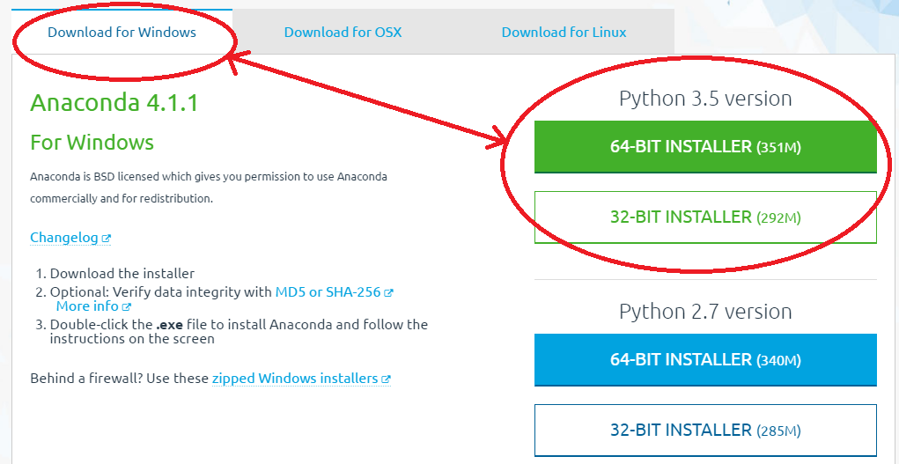
Windows Operating System
Dr Vijendra

Slide 73
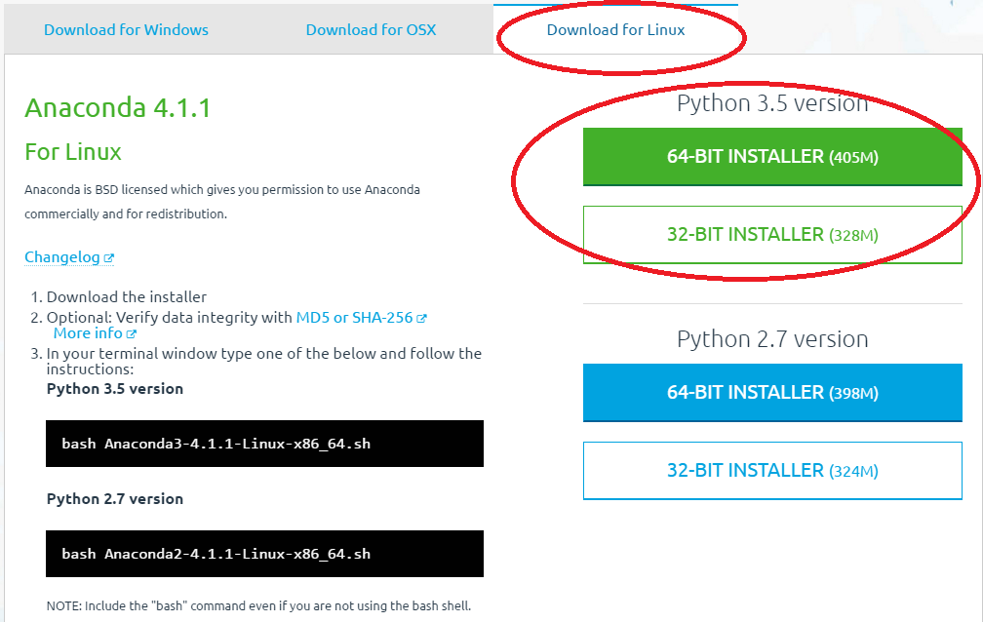
Linux Operating Systems
Dr Vijendra

Slide 74
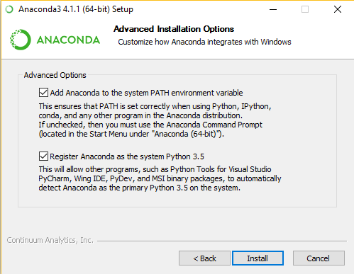
Dr Vijendra

Slide 75
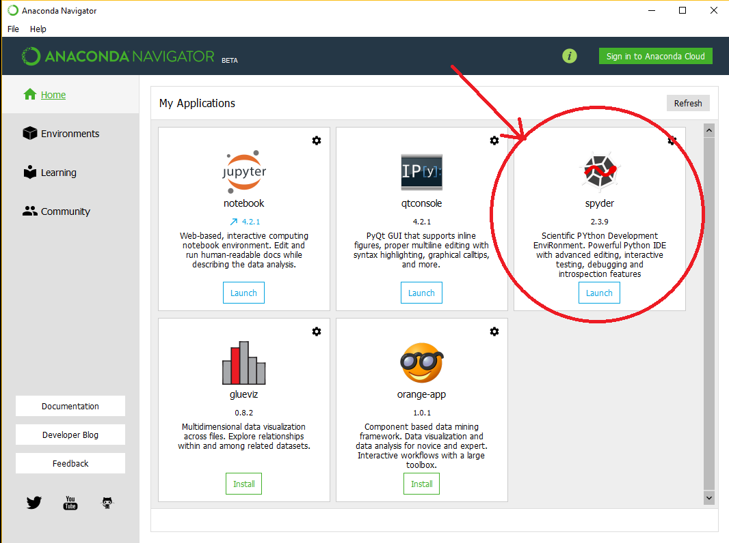
Dr Vijendra

Slide 76
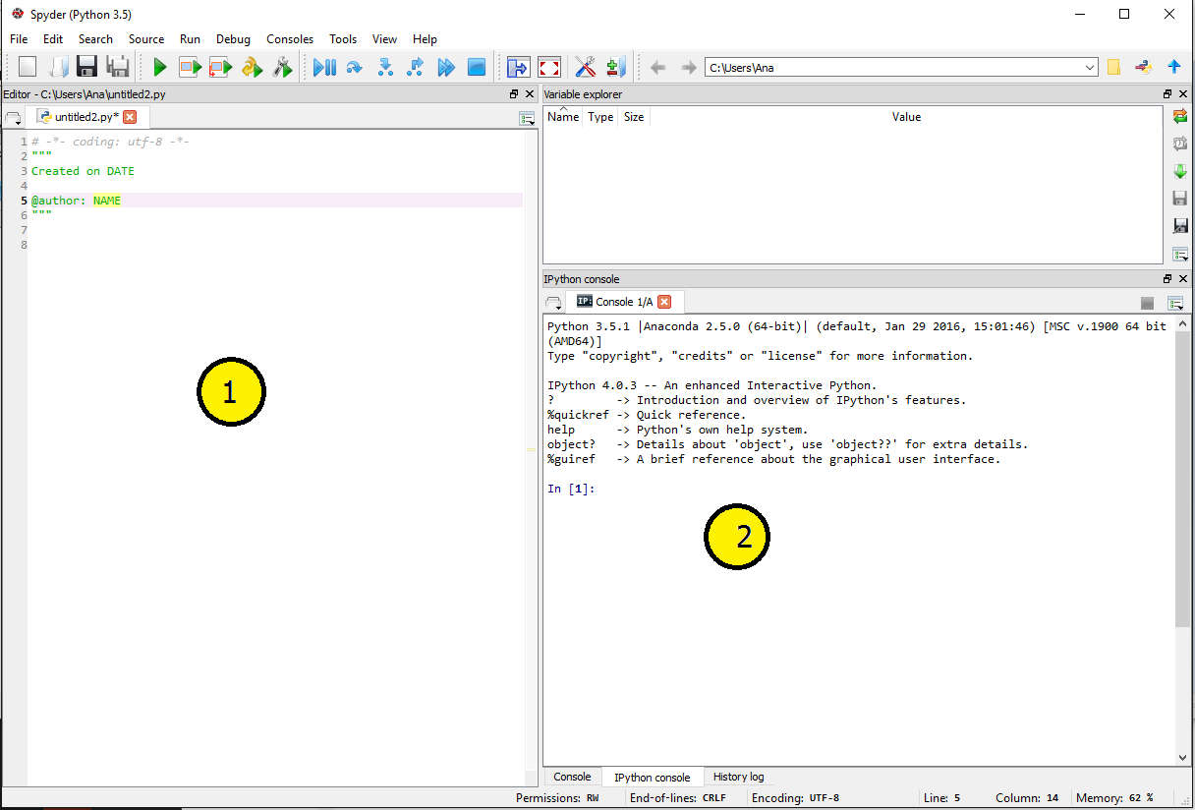
Dr Vijendra

Slide 77
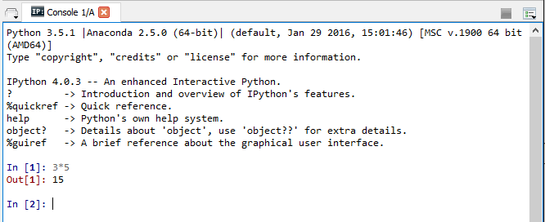
IPython prompt
Dr Vijendra

Slide 78
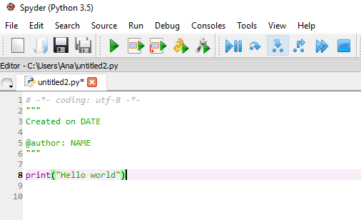
Dr Vijendra

Slide 79
packages
Dr Vijendra

Slide 80
Numpy
NumPy is the fundamental package for scientific computing with Python. It contains among other things:
A powerful N-dimensional array object
Sophisticated (broadcasting) functions
Tools for integrating C/C++ and Fortran code
Useful linear algebra, Fourier transform, and random number capabilities
Dr Vijendra

Slide 81
Bokeh
Bokeh is a Python interactive visualization library that targets modern web browsers for presentation. Its goal is to provide elegant, concise construction of novel graphics in the style of D3.js, but also deliver this capability with high-performance interactivity over very large or streaming datasets. Bokeh can help anyone who would like to quickly and easily create interactive plots, dashboards, and data applications.
Dr Vijendra

Slide 82
Pandas
pandas is a library for data manipulation and analysis:
Data structures: TimeSeries and DataFrame
An integrated group by engine for aggregating and transforming data sets
Input/Output tools: loading tabular data from flat files (CSV, delimited, Excel 2003), and saving and loading pandas objects from the fast and efficient PyTables/HDF5 format.
Memory-efficent “sparse” versions of the standard data structures for storing data that is mostly missing or mostly constant (some fixed value)
Moving window statistics (rolling mean, rolling standard deviation, etc.)
Dr Vijendra

Slide 83
pandas
Some pandas data structures you may be interested in:
  Series – a one-dimensional, labeled array capable of holding any data type – axis labels are collectively referred to as the “index”
  DataFrame – a 2-dimensional data structure with columns of potentially different types (essentially a high performance table object)

Slide 84
Numpy and Pandas
The data manipulation capabilities of pandas are built on top of the numpy library. In a way, numpy is a dependency of the pandas library.
Pandas is best at handling tabular data sets comprising different variable types (integer, float, double, etc.). In addition, the pandas library can also be used to perform even the most naive of tasks such as loading data or doing feature engineering on time series data.
Dr Vijendra

Slide 85
Numpy and Pandas
Numpy is most suitable for performing basic numerical computations such as mean, median, range, etc. Alongside, it also supports the creation of multi-dimensional arrays.
Numpy library can also be used to integrate C/C++ and Fortran code.
Remember, python is a zero indexing language unlike R where indexing starts at one.
The best part of learning pandas and numpy is the strong active community support you'll get from around the world.
Dr Vijendra

Slide 86
Numpy and Pandas
#load the library and check its version, just to make sure we aren't using an older version
import numpy as np
#create a list comprising numbers from 0 to 9
L = list(range(10))
Dr Vijendra

Slide 87
Numpy and Pandas
#creating arrays
np.zeros(10, dtype='int') array([0, 0, 0, 0, 0, 0, 0, 0, 0, 0])
#creating a 3 row x 5 column matrix
np.ones((3,5), dtype=float)
array([[ 1., 1., 1., 1., 1.],
    [ 1., 1., 1., 1., 1.],
    [ 1., 1., 1., 1., 1.]])
Dr Vijendra

Slide 88
Numpy and Pandas
#creating a matrix with a predefined value np.full((3,5),1.23)
array([[ 1.23, 1.23, 1.23, 1.23, 1.23],
[ 1.23, 1.23, 1.23, 1.23, 1.23],
[ 1.23, 1.23, 1.23, 1.23, 1.23]])
#create an array with a set sequence
np.arange(0, 20, 2)
array([0, 2, 4, 6, 8,10,12,14,16,18])
Dr Vijendra

Slide 89
Numpy and Pandas
# import the pandas library
import pandas as pd
left = pd.DataFrame({
'id':[1,2,3,4,5],
'Name': ['Alex', 'Amy', 'Allen', 'Alice', 'Ayoung’], 'subject_id':['sub1','sub2','sub4','sub6','sub5']})
right = pd.DataFrame( {
'id':[1,2,3,4,5],
'Name': ['Billy', 'Brian', 'Bran', 'Bryce', 'Betty’], 'subject_id':['sub2','sub4','sub3','sub6','sub5']})
print left
print right
Dr Vijendra

Slide 90
Numpy and Pandas
Grouping data sets is a frequent need in data analysis where we need the result in terms of various groups present in the data set.
import pandas as pd
ipl_data = {'Team': ['Riders', 'Riders', 'Devils', 'Devils', 'Kings',
'kings', 'Kings', 'Kings', 'Riders', 'Royals', 'Royals', 'Riders'],
'Rank': [1, 2, 2, 3, 3,4 ,1 ,1,2 , 4,1,2],
'Year': [2014,2015,2014,2015,2014,2015,2016,2017,2016,2014,2015,2017],
'Points':[876,789,863,673,741,812,756,788,694,701,804,690]}
df = pd.DataFrame(ipl_data)
grouped = df.groupby('Year')
print grouped.get_group(2014)
Dr Vijendra

Slide 91
Numpy and Pandas
Pandas provides various facilities for easily combining together Series, DataFrame, and Panel objects.
import pandas as pd
one = pd.DataFrame({
'Name': ['Alex', 'Amy', 'Allen', 'Alice', 'Ayoung'],
'subject_id':['sub1','sub2','sub4','sub6','sub5'],
'Marks_scored':[98,90,87,69,78]},
index=[1,2,3,4,5])
two = pd.DataFrame({
'Name': ['Billy', 'Brian', 'Bran', 'Bryce', 'Betty'],
'subject_id':['sub2','sub4','sub3','sub6','sub5'],
'Marks_scored':[89,80,79,97,88]},
index=[1,2,3,4,5])
print pd.concat([one,two])
Dr Vijendra

Slide 92
Matplotlib
matplotlib is a python 2D plotting library which produces publication quality figures in a variety of hardcopy formats and interactive environments across platforms. matplotlib can be used in python scripts, the python and ipython shell, web application servers, and six graphical user interface toolkits.
MPLD3
The mpld3 project brings together Matplotlib, and D3js, the popular Javascript library for creating interactive data visualizations for the web. The result is a simple API for exporting your matplotlib graphics to HTML code which can be used within the browser, within standard web pages, blogs, or tools such as the IPython notebook.
Dr Vijendra

Slide 93
NLTK(Natural Language Toolkit)
A library to deal with English language. It provides easy-to-use interfaces to over 50 corpora and lexical resources such as WordNet, along with a suite of text processing libraries for classification, tokenization, stemming, tagging, parsing, and semantic reasoning, and an active discussion forum.
Scraping Websites
requests + LXML
Extracting prices and buyers
Dr Vijendra

Slide 94
BeautifulSoup
Extracting hyperlinks from Google homepage.
from bs4 import BeautifulSoup
r = requests.get("http://www.google.com")
data = r.text
soup = BeautifulSoup(data)
Dr Vijendra

Slide 95
NetworkX (Graph Library)
A library to construct, manipulate and visualize graphs, it contains:
Data structures for graphs, digraphs, and multigraphs.
Nodes and edges can hold arbitrary data
Generators for classic graphs, random graphs, and synthetic networks
Standard graph algorithms and Network analysis measures
Dr Vijendra

Slide 96
Reading HTML Pages
Install Beautifulsoup
Use the Anaconda package manager to install the required package and its dependent packages.
conda install Beaustifulsoap
Dr Vijendra

Slide 97
import urllib2
from bs4 import BeautifulSoup
# Fetch the html file
response = urllib2.urlopen('//https://www.computerhope.com/jargon/h/html.htm')
html_doc = response.read()
# Parse the html file
soup = BeautifulSoup(html_doc, 'html.parser')
# Format the parsed html file
strhtm = soup.prettify()
# Print the first few characters
print (strhtm[:225])
Dr Vijendra

Slide 98
import urllib2
from bs4 import BeautifulSoup
response = urllib2.urlopen('http://https://www.computerhope.com/jargon/h/html.htm')
html_doc = response.read()
soup = BeautifulSoup(html_doc, 'html.parser')
for x in soup.find_all('b'): print(x.string)
Dr Vijendra

Slide 99
Word tokenization
Word tokenization is the process of splitting a large sample of text into words.
This is a requirement in natural language processing tasks where each word needs to be captured and subjected to further analysis like classifying and counting them for a particular sentiment etc.
The Natural Language Tool kit(NLTK) is a library used to achieve this.
Install NLTK before proceeding with the python program for word tokenization.
Dr Vijendra

Slide 100
conda install -c anaconda nltk
import nltk
word_data = "It originated from the idea that there are readers who prefer learning new skills from the comforts of their drawing rooms"
nltk_tokens = nltk.word_tokenize(word_data)
print (nltk_tokens)
Dr Vijendra

Slide 101
Tokenizing Sentences
import nltk
sentence_data = "Sun rises in the east. Sun sets in the west.“
nltk_tokens = nltk.sent_tokenize(sentence_data)
print (nltk_tokens)
Dr Vijendra

Slide 102
Stemming and Lemmatization
In the areas of Natural Language Processing we come across situation where two or more words have a common root.
For example, the three words - agreed, agreeing and agreeable have the same root word agree. A search involving any of these words should treat them as the same word which is the root word.
So it becomes essential to link all the words into their root word.
Dr Vijendra

Slide 103
import nltk
from nltk.stem.porter import PorterStemmer
porter_stemmer = PorterStemmer() word_data = "It originated from the idea that there are readers who prefer learning new skills from the comforts of their drawing rooms" # First Word tokenization
nltk_tokens = nltk.word_tokenize(word_data) #Next find the roots of the word
for w in nltk_tokens:
print "Actual: %s Stem: %s" % (w,porter_stemmer.stem(w))
Dr Vijendra

Slide 104
Lemmatization is similar ti stemming but it brings context to the words.
So it goes a steps further by linking words with similar meaning to one word.
For example if a paragraph has words like cars, trains and automobile, then it will link all of them to automobile
Dr Vijendra

Slide 105
import nltk
from nltk.stem import WordNetLemmatizer
wordnet_lemmatizer = WordNetLemmatizer()
word_data = "It originated from the idea that there are readers who prefer learning new skills from the comforts of their drawing rooms" nltk_tokens = nltk.word_tokenize(word_data)
for w in nltk_tokens:
print "Actual: %s Lemma: %s" % (w,wordnet_lemmatizer.lemmatize(w))
Dr Vijendra

Slide 106
THANK YOU
Dr Vijendra

